Slide 1
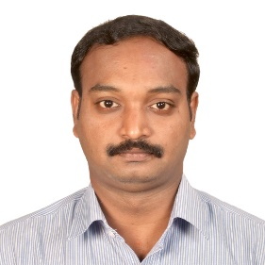
Manivasagan Namasivayam – L0 Nominee
BU Grade/Global Grade | DM/C | E-Mail Address | Manivasagan.Namasivayam@capgemini.com
Country/SBU | India/I&D | Account | ACIS
Delivery and Market Development
Took architectural design and change responsibilities of the MUFG AML Clean slate project as a Technical Project manager. Leaded ETL team from Offshore managed 25 members development and 5 members Support team and provided technical solutions for the informatica related issues. Had worked on banking Project and the client is from Japan Bank. The Bank of Tokyo Mitsubishi(BTMU) operates from New York, USA corporate banking. Develop insights and translates them into data structures and data model requirements. He involved in implementing the Data Validation & Reconciliation. Total 34 TB data migrated from HCP system to Network Rail Share point portal using Pentaho as ETL tool.
Capgemini Contribution
Contributed on significant proof of concept work to prove the integration as well as technical leadership to manage the customer expectations about what was feasible given time and budget constraints. Actively participated in I&D interview panel during MUFG project recruited 25+ resources to Capgemini Provided consultation to Lend lease and MUFG account in Capgemini technical team to provide technical solutions to various complex problems. As a Project lead provided End to End solution in P4D project for UK Network Rail project. Constructed ETL Design, given Development and deployment solutions for P4D project.
Thought Leadership
Widely regarded as subject matter expert in the Banking and Media domain. Multiple project solutions provided for NBCU account in Box office revenue related analytical project. Provided wide range of mentor activities for the existing resources & freshers in emerging new technologies Created Knowledge transfer forum & arranged training sessions, trained the ETL concepts to new resources.
Commitment to Architecture
Having completed L0 Architect Certification current month have encouraged a number of colleagues to gain their certification and have coached them on the application process._ In HCP to SPO migration project did R&D and provided the right solution as Sharegate tool while team struggled with Power Shell coding to upload the targeted huge volume data.

